Slide 1

Proposal for SDG-Active
GISC 6354 – Information Management
Author – Victoria Ebeh
02/22/2024

Slide 2
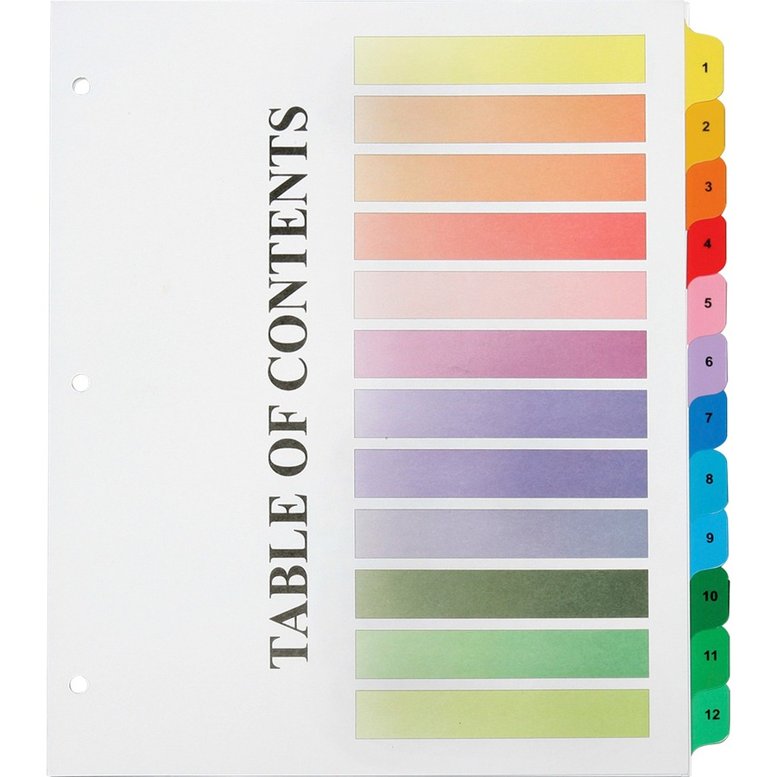
Table of contents
Introduction
Data
Methods
References

Slide 3
INTRODUCTION

Slide 4

Sustainable Development Goals (SDGs)
The Sustainable Development Goals (SDGs), adopted by all United Nations Member States in 2015, provide a universal call to action to end poverty, protect the planet, and ensure prosperity for all by 2030.
There are 17 goals in total.
Global focus on sustainability created a need for a platform that promotes awareness and engages individuals in SDG-related activities.
This proposal outlines the development of SDG-Active, which is designed to connect users with events aligned with their interests and the SDGs they are passionate about.

Slide 5
Aim
Objectives
The aim of this project is to create a user-friendly app and database that actively contributes to the advancement of Sustainable Development Goals through connectivity and actions.
Connecting users with relevant events around them.
Promoting awareness and/or active participation in SDG-related activities.
Facilitating user engagement and feedback on both events and the app itself.
Fostering a sense of community among individuals committed to sustainable development.

Slide 6
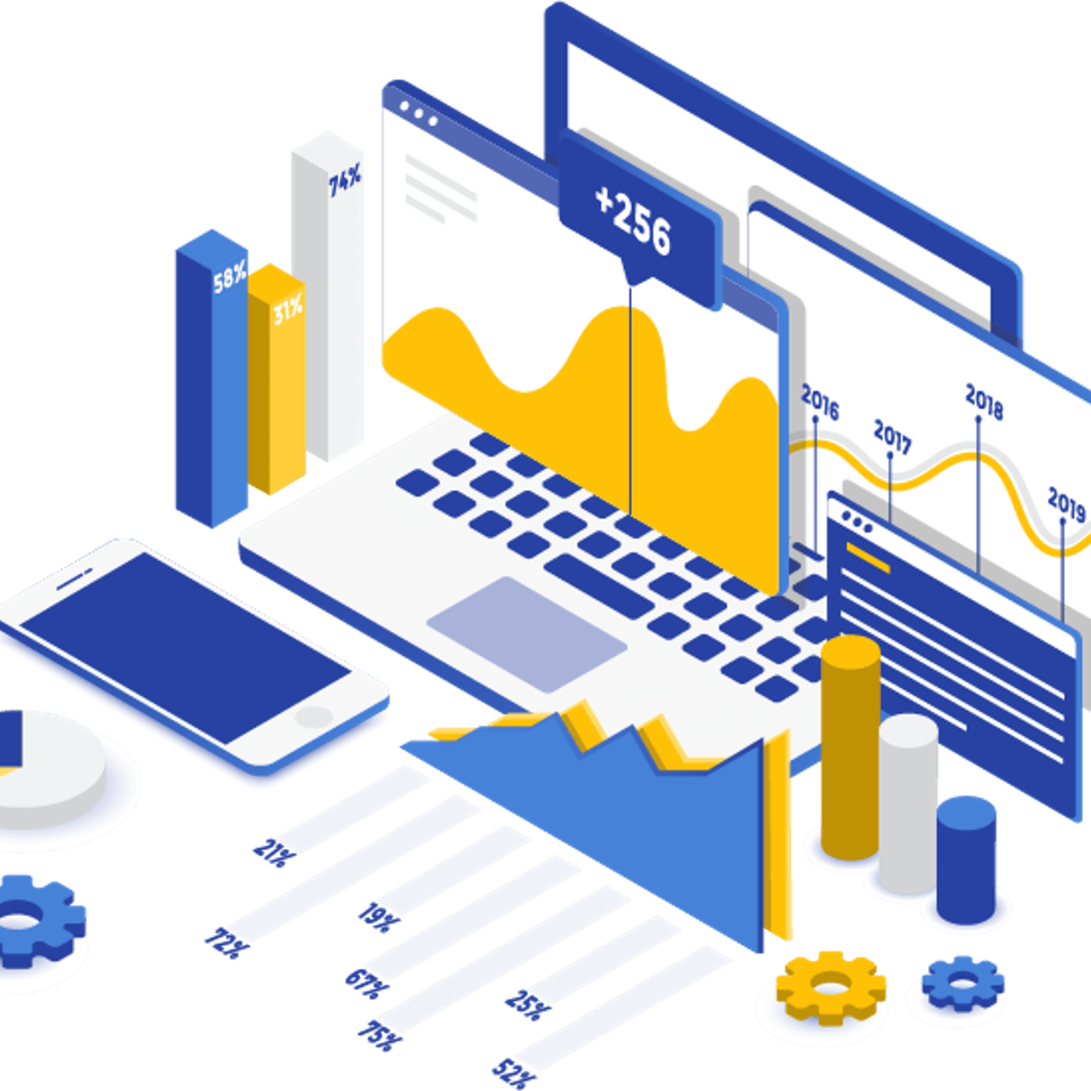
Data
Source: ProfitLine

Slide 7
Data
Data Sources
Event Data: This includes event details (name, date, location, organizers) and the SDG alignment tags for events.
User Data: This will include user profiles (preferences, interests, attended events) and feedback sections.
SDG Information: Detailed information on each Sustainable Development Goal.
Geospatial Data: This will include locational data for events and users(maps).
United Nations: SDG Actions Platforms - https://sdgs.un.org/partnerships
The names of students from our class (as possible users/organizers). No real personal information will be disclosed or utilized in this project and ethics will be considered.
In certain sections of this project, dummy/fabricated data will be used.

Slide 8
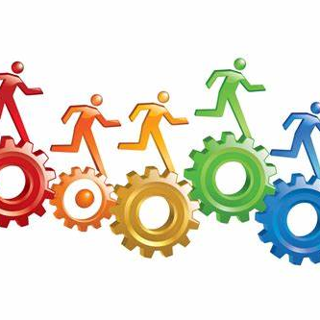
methodology

Slide 9
methods
Relational Database Design:
For this project, a relational database design will be used. Relational databases are based on the relational model, which organizes data into tables with rows and columns, and establishes relationships between tables (Silberschatz, A. et al, 2011). It is;
Well-established
Strong support
Suitable for complex relationships.
The database will be created using a Relational Database Management System (RDBMS), known as PostgreSQL. This is an open-source object-relational database system that uses and extends the SQL language to safely store and scale the most complicated data workloads (PostgreSQL, 2024)

Slide 10
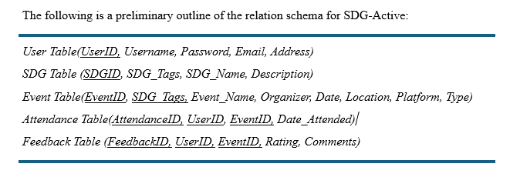
Database schema
The following is a preliminary outline of the relation schema for SDG-Active:

Slide 11
Web app interface
Map Representations/capabilities: It will use maps to show locational data. For example, show nearest events to users, etc.
Feedback Mechanism: It will include feedback mechanisms for users to report issues about the app/events or suggest improvements.
User Permissions: There will be a control system to manage user authentication/authorization and ensure users only have access to the resources relevant to their roles (Frontegg, 2022)
Dashboard: The dashboard will display key information and provide visual elements like charts for quick insights. For example, the number of people interested in particular events or SDGs, notifications, etc.
Navigation menu/home menu: There will be a navigation menu for easy access to different sections (UXPin, 2023).
Data entry/Search and Filters: User-friendly forms for easy data entry with clear labels/instructions. There will be a search tool or function for quick data retrieval. There will also be a filter function so users can refine their searches based on specific needs. (UXPin, 2023).

Slide 12
References
United Nations-Department of Economic and Social Affairs Sustainable Development. (2024). THE 17 GOALS. Retrieved from United Nations: https://sdgs.un.org/goals
Silberschatz, A., Korth, H. F., & Sudarshan, S. (2011). Database system concepts. McGraw-Hill.
UXPin. (2023, August). User Interface Elements Every Designer Should Know. Retrieved from UXPin : https://www.uxpin.com/studio/blog/user-interface-elements-every-designer-should-know/
PostgreSQL. (2024). About. Retrieved from PostgreSQL: https://www.postgresql.org/about/
Frontegg. (2022, June). User management - What Are User Permissions? Concepts, Examples, and Maintenance. Retrieved from Frontegg: https://frontegg.com/guides/user-permission

Slide 13

Thank you!

